Slide 1


SAP CLOUD APPLICATION PROGRAMMING AND XSA TRAINING IN BTP
Anubhav Oberoy
Day – 8

Slide 2
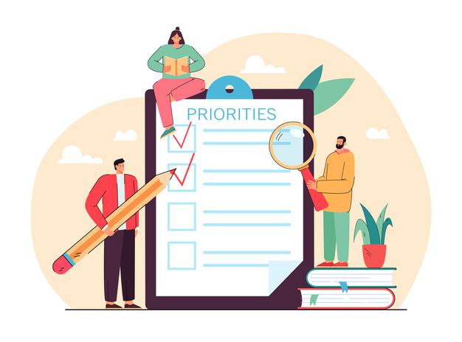
Agenda – Day 8
Introduction to CDS Query Language (CQL)
Debugging in NodeJS
What is SAP UI5?
Responsive web design
Client Server Architecture
Structure of UI5 Project
Understanding the MVC Architecture
Introduction to Fiori Elements
Advantages of Using Fiori Elements
Freestyle V/S Fiori Elements Apps
Fiori List Report Application
Fiori Annotation Introduction
Adding Filter Fields and Columns using annotation
Adding Custom Columns and Formatting Column Values

Slide 3
CDS Query Language (CQL)
The CDS Query Language (QL) is an extension to SQL used to consume CDS data. The QL includes enhancements such as defining views within the CDS data model. It also introduces the use of associations defined by the DDL. Instance-based authorization to CDS entities are defined using the Data Control Language (DCL).
CQL allows to put projections, that means, the SELECT clause, behind the FROM clause enclosed in curly braces. For example, the following are equivalent:
SELECT nameFirst, email from employees
We can also use the CQL in NodeJS to perform custom database operations at the runtime of the application. The above CQL statement can be written in NodeJS as:
//CDS Query Language - SELECT * FROM dbtab
SELECT.from(employees).columns(nameFirst, email)
The filter statements in NodeJS to get the filter data is written the CDS Query Notation.
CQN is a canonical plain object representation of CDS queries. Such query objects can be obtained by parsing CQL, by using the query builder APIs, or by simply constructing respective objects directly in your code.
Example:
{SELECT:{from:[{ref:['employees']}]}}

Slide 4
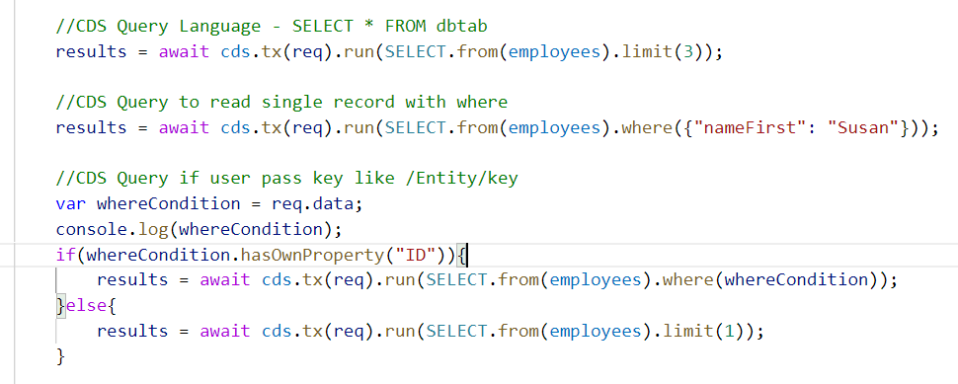
Hands-no: CDS Query Language
In this exercise we will see how to use the CDS Query Language to perform database operations at run time.
Exercise Code/resources:
myfirstservice.cds
Test.http

Slide 5
Custom Actions and Function in CAPM
Actions and Functions allow us to modify or perform additional operations of the data which is beyond simple CURD functionality.
Actions
Actions are operations exposed by an OData service that MAY have side effects when invoked. Actions MAY return data but MUST NOT be further composed with additional path segments.
Functions
Functions are operations exposed by an OData service that MUST return data and MUST have no observable side effects.
Simply put, Actions can be used to modify data, while Functions are used to get specific (set of) data.
Within service definitions, you can additionally specify actions and functions. Use a comma-separated list of named and typed inbound parameters and an optional response type, which can be either a:
entity POs as projection on transaction.purchaseorder actions{
function largestOrder() returns array of POs;
action boost();
}

Slide 6
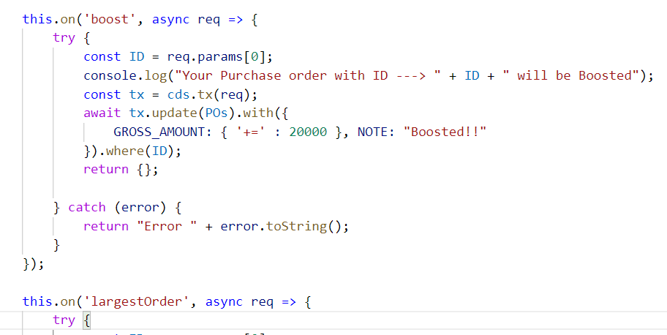
Hands-on: Actions and Functions
Create a custom boost action and a custom function to get the largest order in the Catalog Service and test it using the Test.http.
Exercise Code/Resource:
CatalogService.cds
CatalogService.js
Test.http

Slide 7
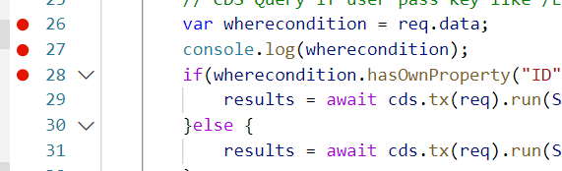
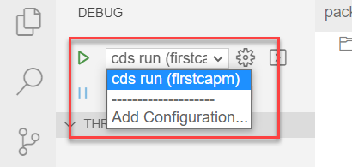
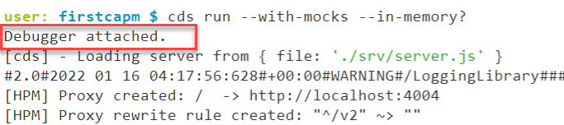
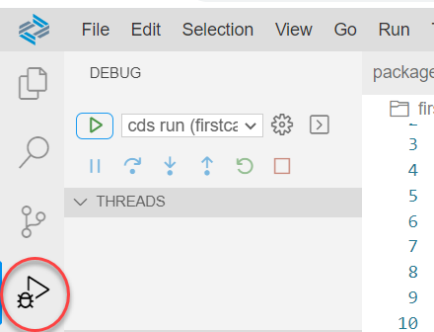
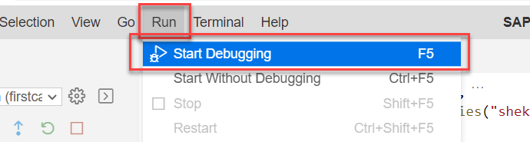
Debugging Node JS in BAS
Debugging is a concept to identify and remove errors (‘bugs’) from software applications.
Using console.log to debug the code generally dives into an infinite loop of “stopping the app and adding a console.log, and start the app again” operations. Besides slowing down the development of the app, it also makes the writing dirty and creates unnecessary code.
So SAP BAS and VS Code provides a better way of debugging the Node.js.
Steps to attach debugger in NodeJS
First Attach the debuggers to the module which we want to debug.
Go to the debug terminal by clicking on the debug icon and select the module you want to debug.
Start the debugger using the start icon on debug window.
You can also start debugging form the Run and Start debugging.
Once starting you will see a Debugger attached in the Terminal.

Slide 8
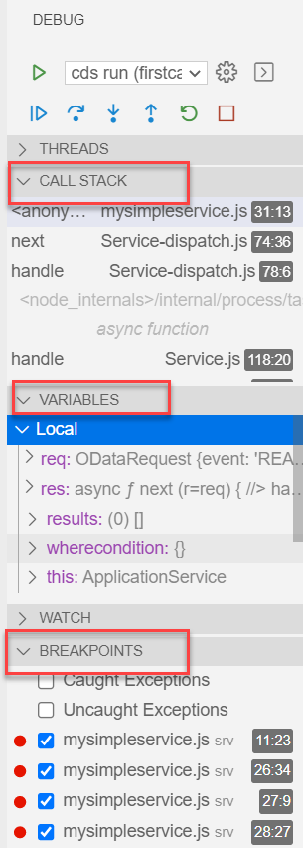
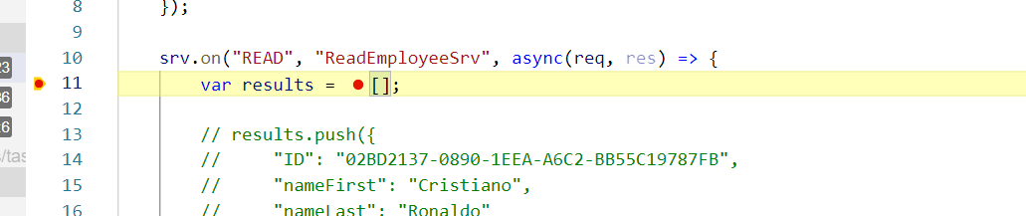
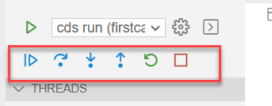
Steps to use debugger
Once the debugger is attached to our application. We should know how to use the debugger window to find the errors and debug the code.
So, when the debugger hit an operation in the BAS it will look like this. And the debug window will show us the variables and the breakpoint which are there in our code.
We can run the debugger step by step as we wanted using the panel given on the debug window.
We can also use shortcuts to move the debugger.
F5 – To move the debugger to the completely until the next break point
F10 – Move debugger to the next line of code.

Slide 9
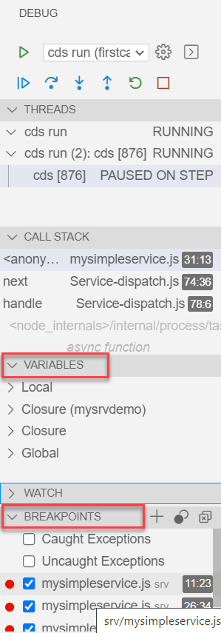
Hands-on: Debugging
Try to debug the NodeJS code in the Business Application Studio. Have a look at the debugging window and perform the operations on the debugging console.

Slide 10


What is SAP UI5?
SAPUI5 (SAP user interface for HTML5) is a collection of libraries that you can use to build desktop and mobile applications that run in a browser. With the SAPUI5 JavaScript toolkit, you can create web applications using HTML5 web development standards.
SAP UI5 is a framework which is used to develop Responsive web applications to run on any platform, any browser and any OS.
Responsive
App which can adapt itself according the different devices
Framework
It’s a collection of Libraries.
Library
Collection of classes.
Classes
Collection of methods, Attributes, Events

Slide 11
Responsive Web Design
Responsive web design (RWD) is a web development approach that creates dynamic changes to the appearance of a web application, depending on the screen size and orientation of the device being used to view it.
Responsive Web Design is about using HTML and CSS to automatically resize, hide, shrink, or enlarge, a website, to make it look good on all devices (desktops, tablets, and phones).
Now a days, all the frameworks are designed to adept the UI according to the screen size of the device.

Slide 12
Client Server Architecture
The task of the client/server technology components is to provide a reusable runtime environment for other components that use the client server technology as the basis on which to process requests. The focus is on optimizing operating system resources (CPU, memory, etc.), in terms of performance, scalability, and robustness.
In addition to the components in the SAP kernel there are programs that regulate data traffic in the network, such as the SAP router and the SAP Web Dispatcher, as well as smaller monitoring and test programs.
SAP
Server
Computer on cloud
IP Address
Fiori
Request – header + body(optional)
Response – header + body(html,xml, json,excel, pdf, word,….)
Request Types
GET – Read Data
POST – Create new Data
PUT – Update
DELETE – Remove Data

Slide 13
Structure of UI5 Framework
The UI5 framework is built on top of open standards like HTML5, CSS, JS, and jQuery. We use MVC architecture to create applications using SAPUI5.
BAS or
VSCode
App
SAP UI5 Design Time Component
SAPUI5 Runtime Component
HTML+CSS+JS
sap.m
sap.ui.comp
sap.ui.table
sap.ui.layout
Renderer
sap.ui.core
sap.ui.unified
sap.ui.core.mvc
HTML5
CSS
JS
jQuery

Slide 14
Introduction to MVC Architecture
MVC stands for Model, View, Controller.
Model:- The model component is a freely composed class that will keep the application data and do manipulations on it. All database accesses are done within the model.
View:- The View is responsible for defining the user interface to users. When a user sends a requests from his device, the view is responsible for data view as per the request submitted.
Controller:- The Controller is used to control the data and view events as per user interaction by updating the view and model.
<event>
Processing
Controller
eventHandler
<notifies>
<done>
<modifies>
I/O
View
Data binding
Data
Models
MVC Architecture

Slide 15
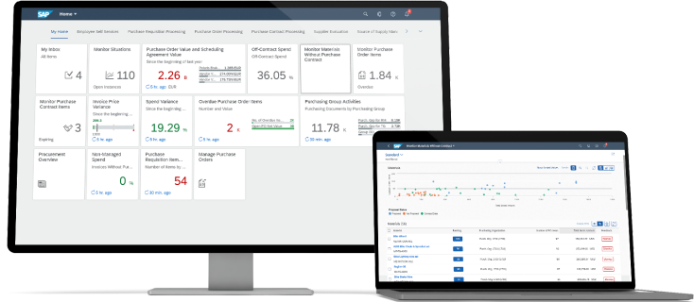
What is SAP Fiori?
SAP Fiori is a design system that enables you to create business apps with a consumer-grade user experience, turning casual users into SAP experts with simple screens that run on any device. By using the SAP Fiori design guidelines and tools that we use at SAP, you can easily build and customize your own apps that are consistent with what we ship with SAP S/4HANA and our other enterprise software solutions.
Improve user satisfaction while increasing productivity and data quality
Work from anywhere with optimized native mobile and responsive Web apps
Adapt and scale development quickly using UI flexibility and rapid development
Advantages
SAP Fiori apps can speed onboarding and reduce training time.
The SAP Fiori design system gives you the templates, tools, and guidelines to create beautiful enterprise apps that users will love. By using SAP Fiori, you can help ensure that your app designs are consistent across all devices.
SAP Fiori, you can provide a consistent user experience across your apps.

Slide 16
Fiori = UX Consistency
UX consistency
Increases adoption of your app
Improves business user productivity
Decreases training time
Improves data quality
Enhances user satisfaction
SAP Fiori elements provides standard floorplans and uses metadata to streamline and accelerate developing SAPUI5 applications.
SAP Fiori elements
Delivers enterprise-ready SAPUI5 apps based on stable, optimized, out-of-the-box UI code
Boosts developer efficiency by scaling development and maintenance in a cost-efficient way
Provides a centrally managed, consistent UX complying with the latest SAP Fiori design
Ensures upgrade stability and forward compatibility
Allows extensibility of standard floorplans with custom controls and logic

Slide 17
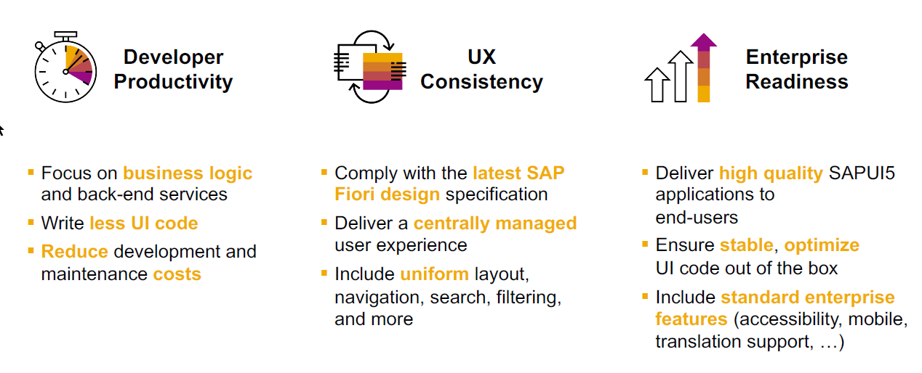
Fiori elements boosts Fiori development efficiency

Slide 18
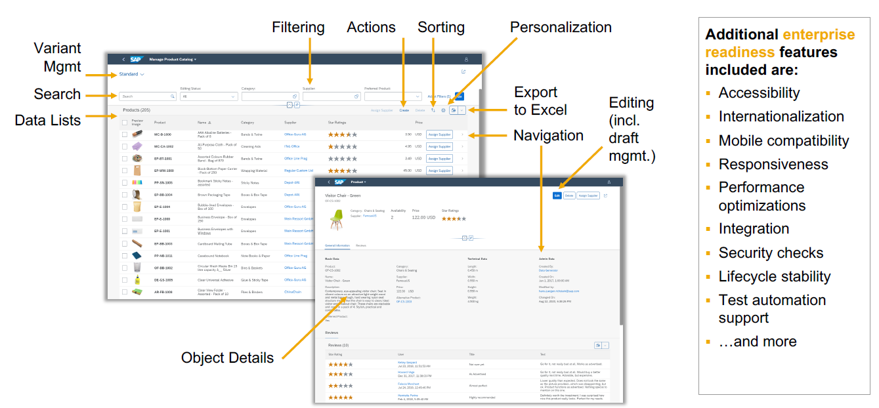
SAP Fiori elements provides enterprise-ready apps out of the box

Slide 19
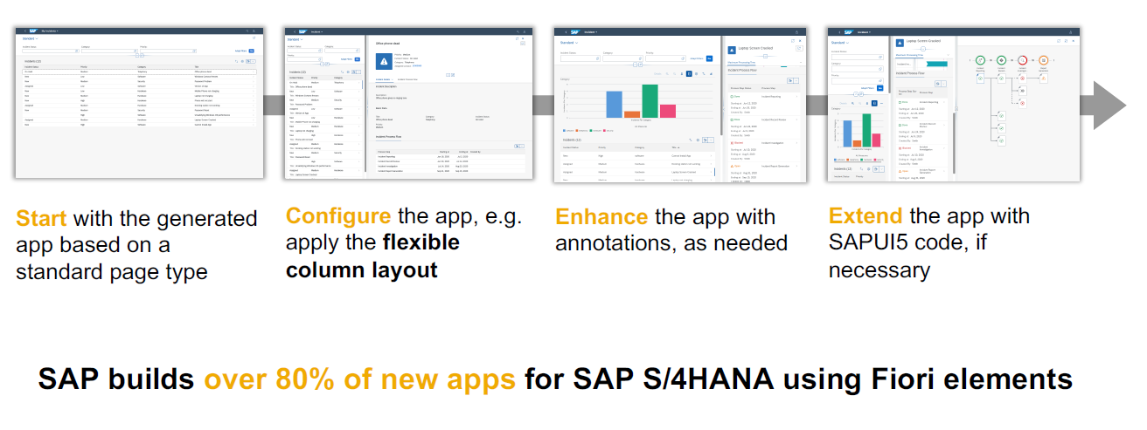
SAP Fiori elements application architecture provides flexibility

Slide 20
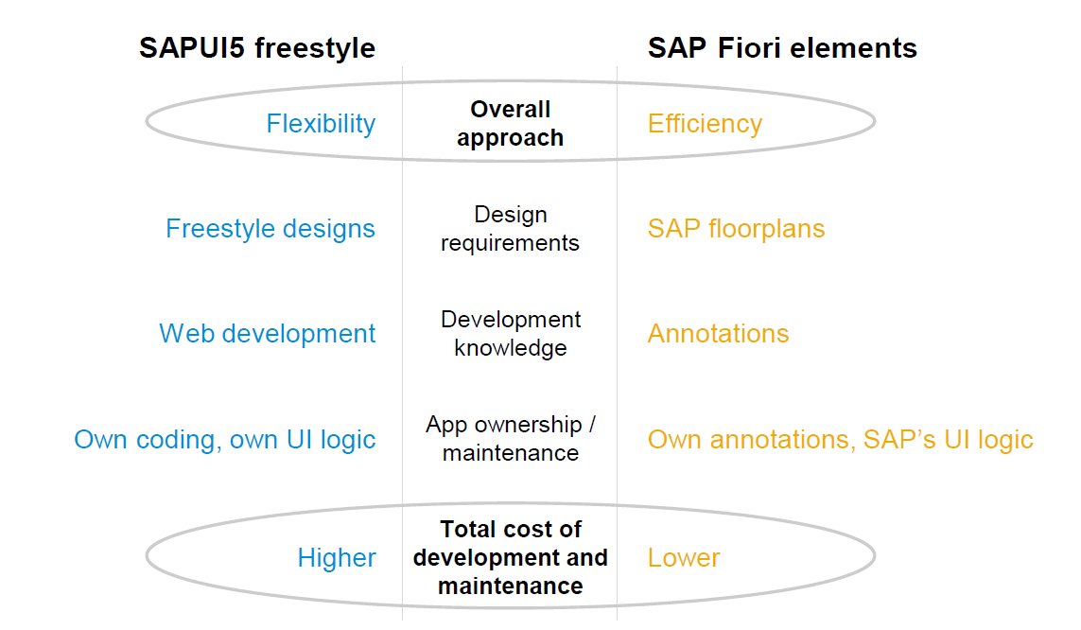
Free Style v/s Fiori Elements Apps

Slide 21
Fiori Elements - List Report Application
The list report offers powerful features for finding and acting on relevant data sets. It is often used as an entry point for navigating to the item details, which are usually shown on an object page.
List Report
Object Page

Slide 22
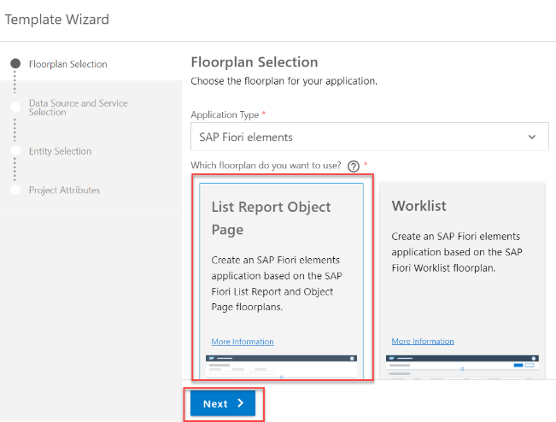
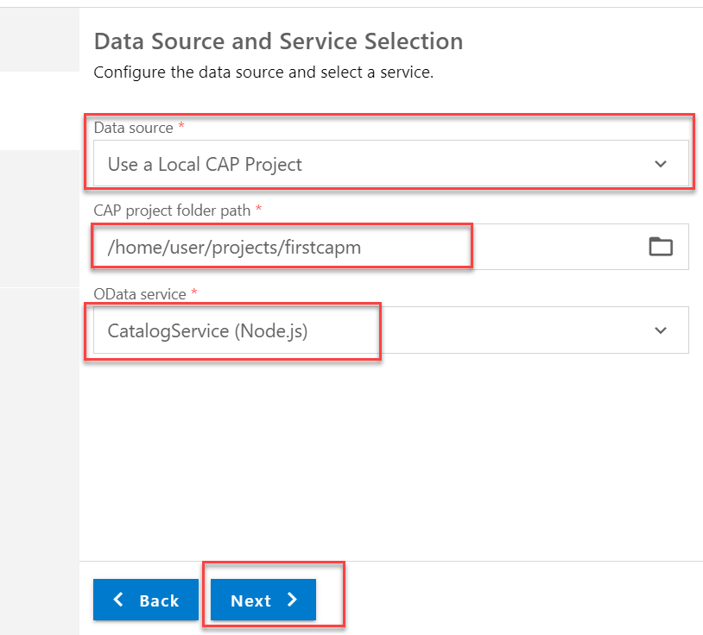
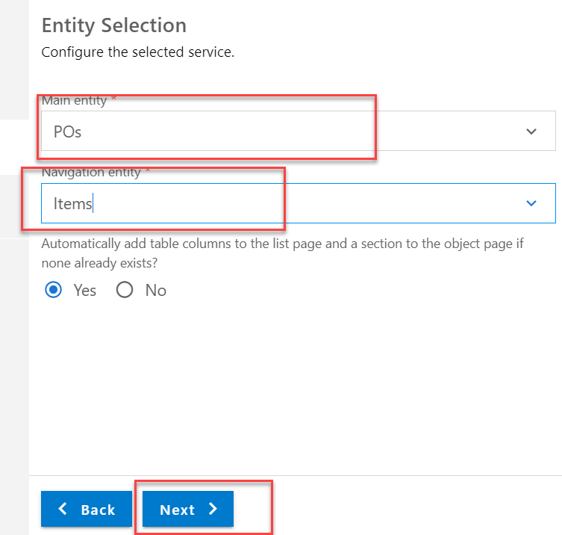
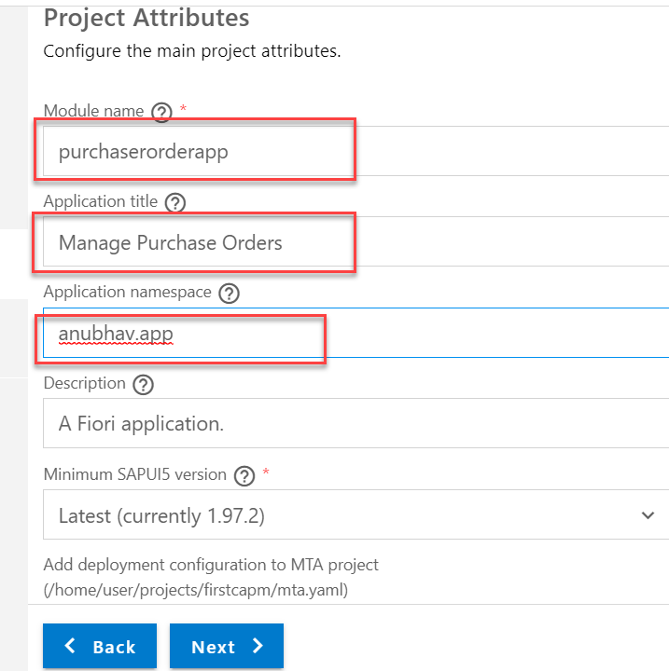
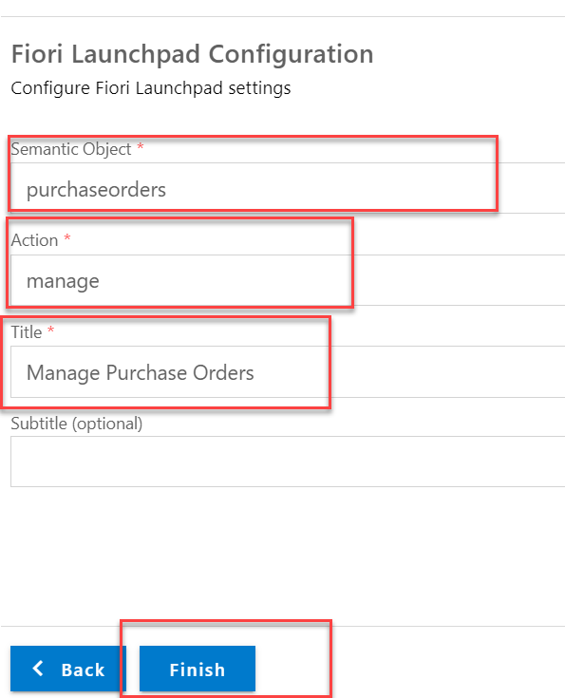
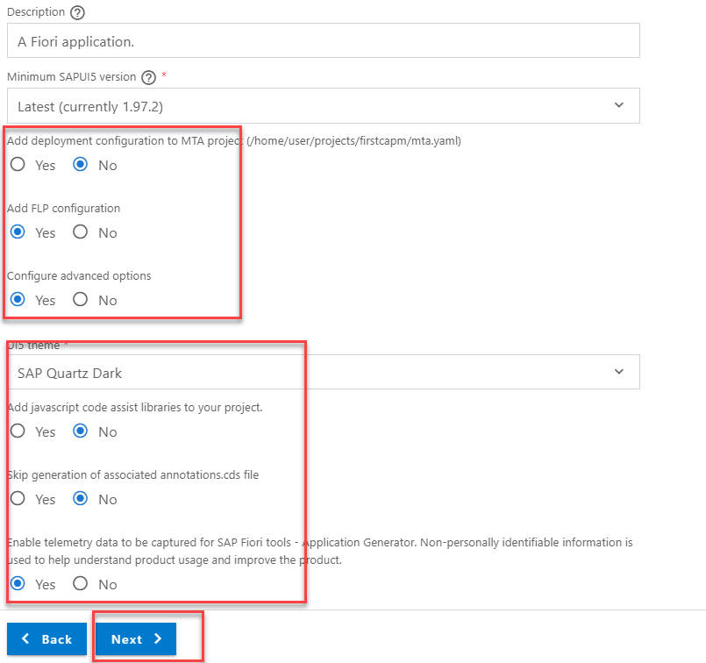
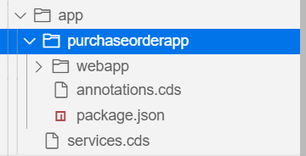
Creating a List Report app using Template
Now we will create a list report application inside our CAPM Project. For that first we need to start the template wizard.
In wizard we have to select the list report application and select the Local CAP Project in Data Source.
Select the service and entity set we want to see on the list report page.

Slide 23
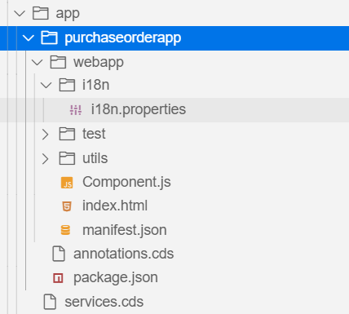
Understanding the Generated Project
The project will be created inside the app folder of our main project. It will contain the UI5 project folder and a .cds file.
This services.cds file will point the annotations.cds file in the purchaseorderapp folder.
The main project folder contains webapp folder, annotations.cds file and package.json
Annotations.cds: - In this file we will create our applications user-interface with the help of UI annotations.
webapp folder: - It contains the starting point of the application (index.html), application descriptor (manifest.json) and component.js file.
package.json: - It contains the information about the dependencies used by the project.
Component.js: - It contains the linkage to the manifest.json file.
Manifest.json: - It contains all the information about the application like, service binding of app, views, models, templates used to build app, routing of the app, etc.

Slide 24
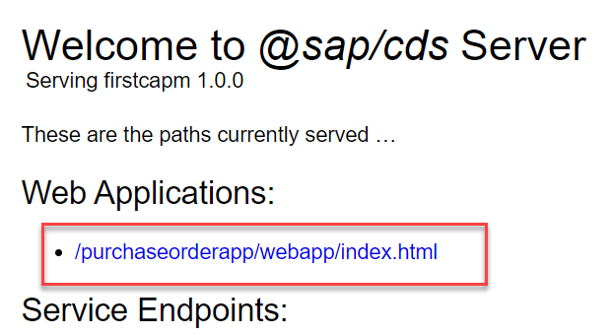
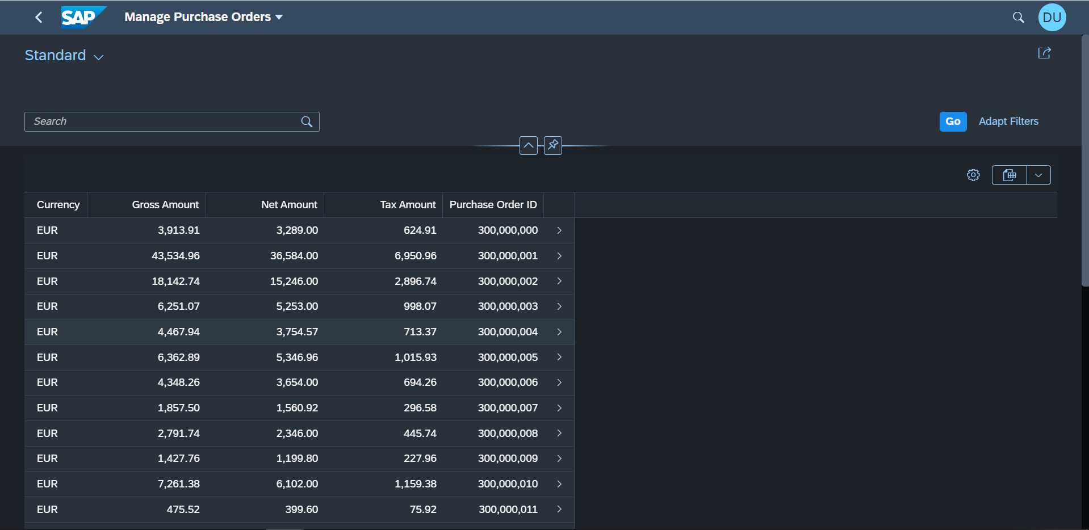
Hands-on: Create LRP using template
Create a list report application in our firstcapm project using the template wizard. Follow the steps given on the previous slide and fill all the information as specified.
Once the application is successfully generated we can run the app using the command cds run or cds watch.
The application endpoint will be available in the Web Application section.

Slide 25
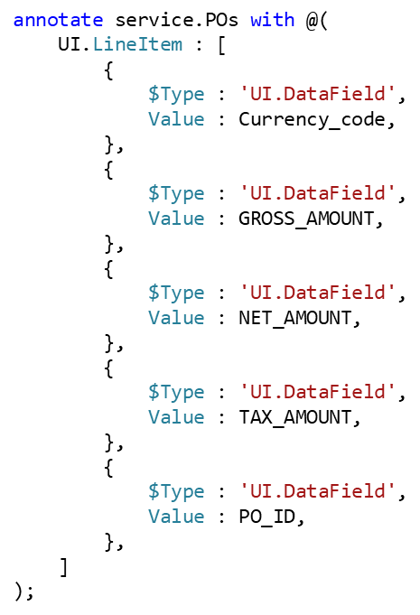
What are SAP Fiori Annotations?
SAP Fiori elements apps are generic frontends, which construct and render the pages and controls based on annotated metadata documents. The annotations provide semantic annotations used to render such content, for example:
In this example we have specified the Table columns with the help of UI.LineItem annotation.
We can use different annotation form the SAP Vocabularies to add specific items to the UI.
The most commonly used Vocabularies are
UI.SelectionFields: It is used to add the filter field in the Smart Filter Bar.
UI.LineItem: It is used to add the Columns in the Table.
UI.HeaderInfo: It is used to add the header information in the UI
UI.Facets: It is used to create the Facets in the UI.
UI.FieldGroup: It is used to Group the data field and Input field in the UI. It is like the form control.
We can get more information about the Annotations with the help of Documentation: https://cap.cloud.sap/docs/advanced/odata#vocabularies

Slide 26
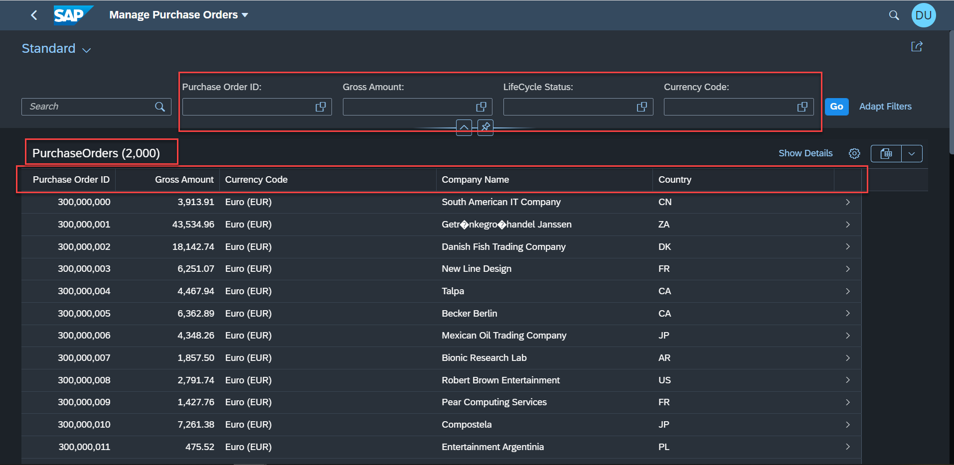
Hands-on: Adding Custom Filters and Columns
Create custom filter fields in the smart filter bar and add custom columns to the List Report Page using the annotations. Along with that we will also add header info to the Table.
Exercise code/resources:-
annotations.cds

Slide 27
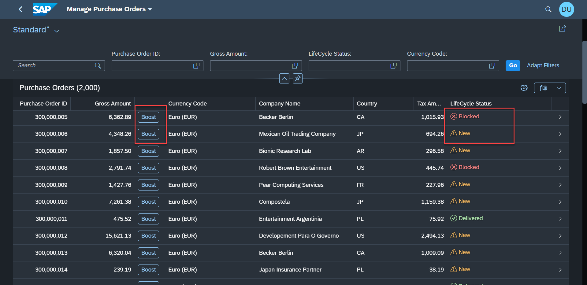
Adding custom Columns to Table
Some time we want to show the data to the user in more fast and convenient manner. For that SAP provides the criticality annotation, using this we can add some visual stuff to our line items like icons, ratings etc.
When you want to attract your business users attention, UI.Criticality is one of the easiest annotations you can use to add some visual bling to your Fiori elements apps. It’s a great option for adding a status icon and a little semantic color to a simple text or date field.
For that we will use the criticality annotation provided by SAP.
So now we want to add a new column and in that column we will add a button to use the boost action we have implemented for the purchase order.
Also we want an status icon to show the Life Cycle Status of the purchase order.

Slide 28
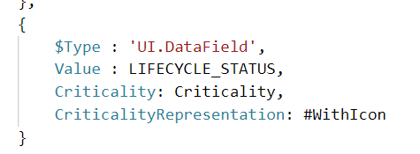
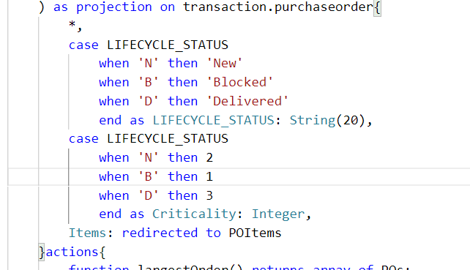
Hands-on: Criticality and Custom Action Button
Add a Criticality annotation to the Life Cycle Status Field and also add a button to boost the Gross amount using the custom action.
Exercise code/resources:
annotations.cds
CatalogService.cds

Slide 29
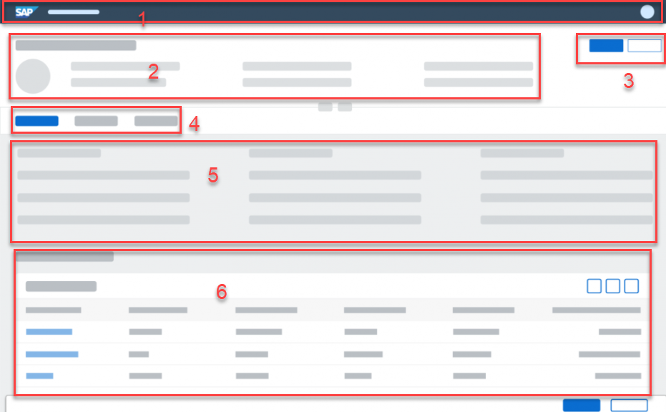
Object Page
The object page floorplan is used to display and categorize all relevant information about an object. Categorized content can be accessed quickly using anchor or tab navigation, and users can switch from display to edit mode to change the content.
Object Page Contains the following Items:
Navigation Bar
Dynamic Header
Action Buttons (Delete, Update)
Facets
Content Area
Line Items Table
Footer Bar

Slide 30
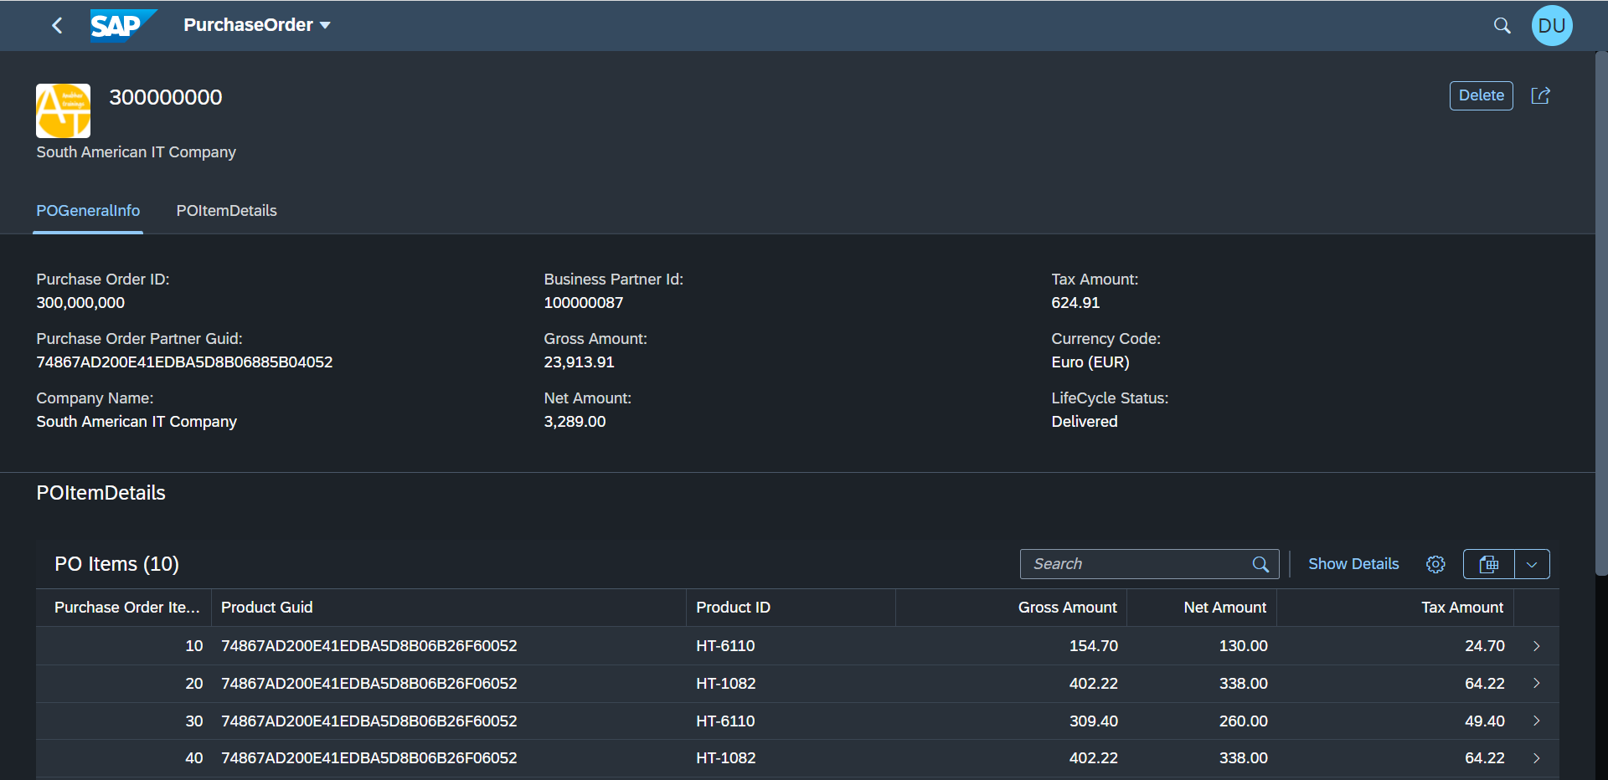
Hands-on: Object Page
Create an Object Page with the help of annotations.
Exercise Code/Resource:-
annotations.cds

Slide 31
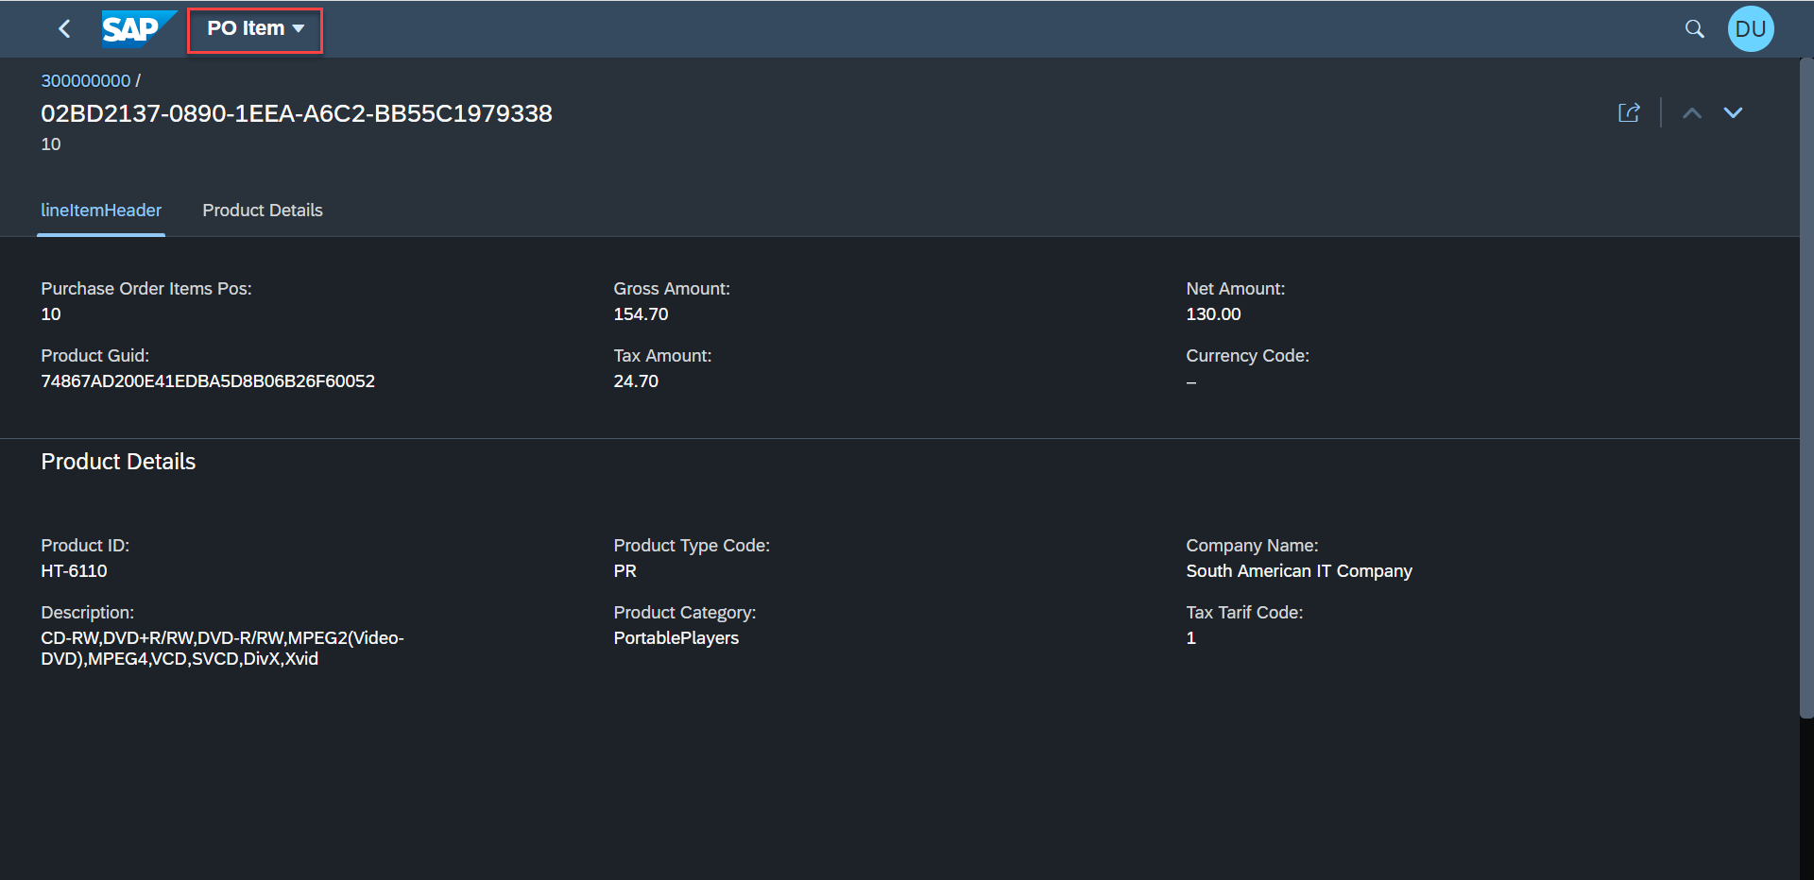
Hands-on: Third Level Drill Down
Create a new Object Page for the Purchase Order Item details.
Exercise code/resource:-
annotations.cds

Slide 32

End of Day 8

Slide 33

Questions

Slide 34

Anubhav Oberoy

Slide 35


We’re committed to empower you to be
Most Desirable Resource
through powerful training solutions.
We build the workforce of the future.
280+
Corporate Clients
30,000+
Learners Trained
28000+
Learners Placed
FREE WEBINARS
Sign up for free webinars with industry experts every fortnight!
Enroll Now!
Contact us today!
https://anubhavtrainings.com/

Slide 36




More from AnubhavTrainings.com

Slide 37
Title
Content

